Slide 1
POWER SUPPLYS L3

Slide 2
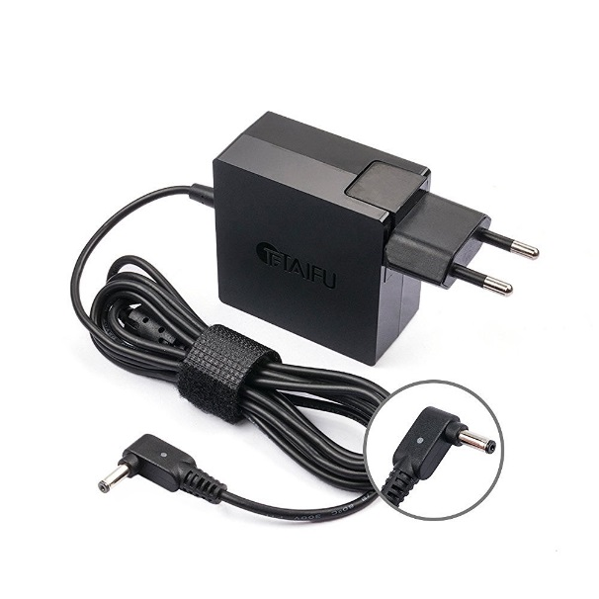

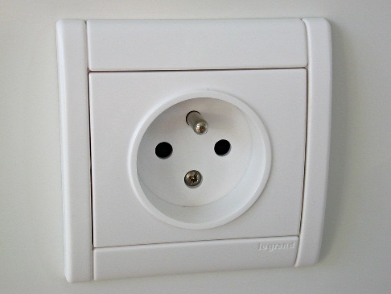
Definition
A power supply is a device that supplies electric energy to an electrical load.
Power supplies are everywhere: computer, electronics, inside any modern electrical equipment (washing machine, …), motor drives,…
Electricity provider Power supply Load

Slide 3
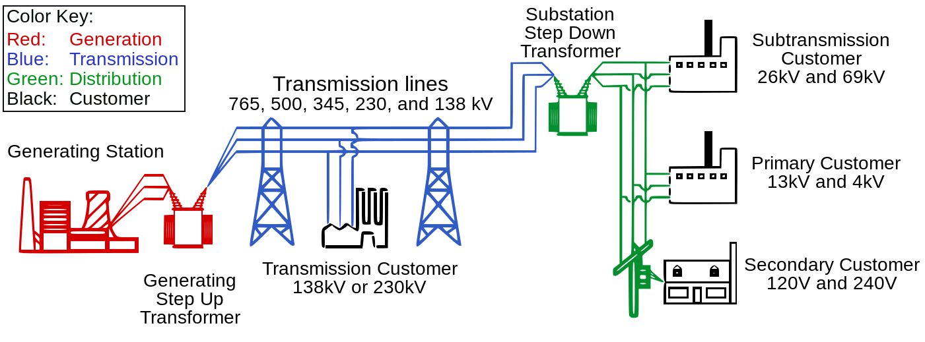
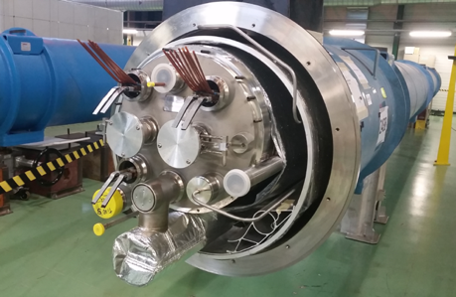
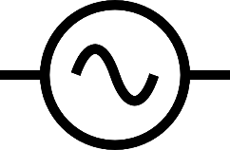

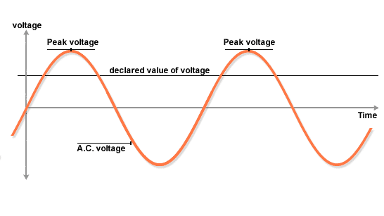
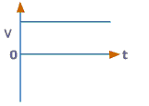
Electrical power
Electricity is mainly produced by rotating machines, generating alternative voltage.
The accelerator magnets need a DC current.
400kV, 225kV, 90kV
63kV, 20kV
20kV, 6kV
400V
Alternative voltage DC current
http://content.tutorvista.com/physics_12/content/media/ac_gen.swf

Slide 4
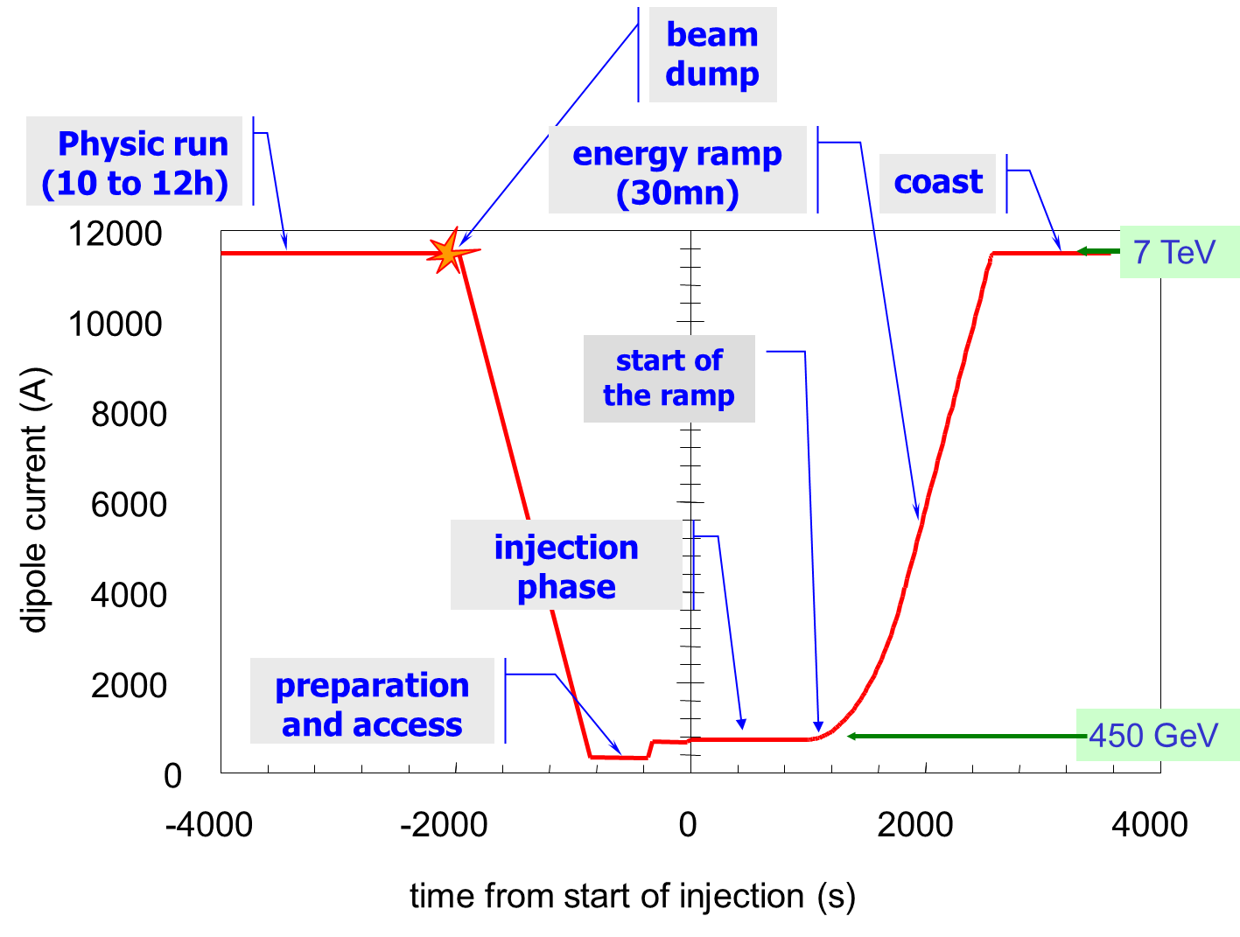
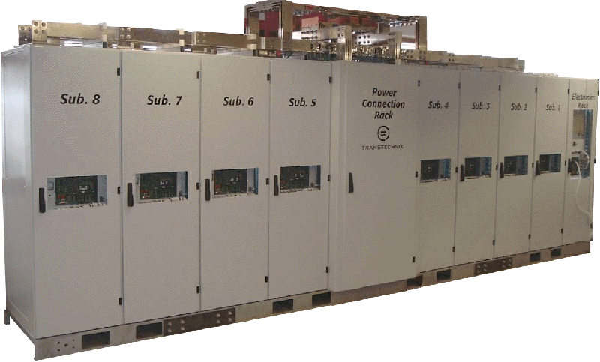

Power supply functions
The tasks of a power supply are to process and control the flow of electric energy by supplying voltage and current in a form that is optimally suited for user loads.
Energy source
Application
Control from CCC

Slide 5
Converters Electronic power converter is the term that is used to refer to a power electronic circuit that converts voltage and current from one form to another.
Rectifier converting an ac voltage to a dc voltage
Inverter converting a dc voltage to an ac voltage
Chopper or a switch-mode power supply that converts a dc voltage to another dc voltage
Cycloconverter and cycloinverter converting an ac voltage to another ac voltage.

Slide 6
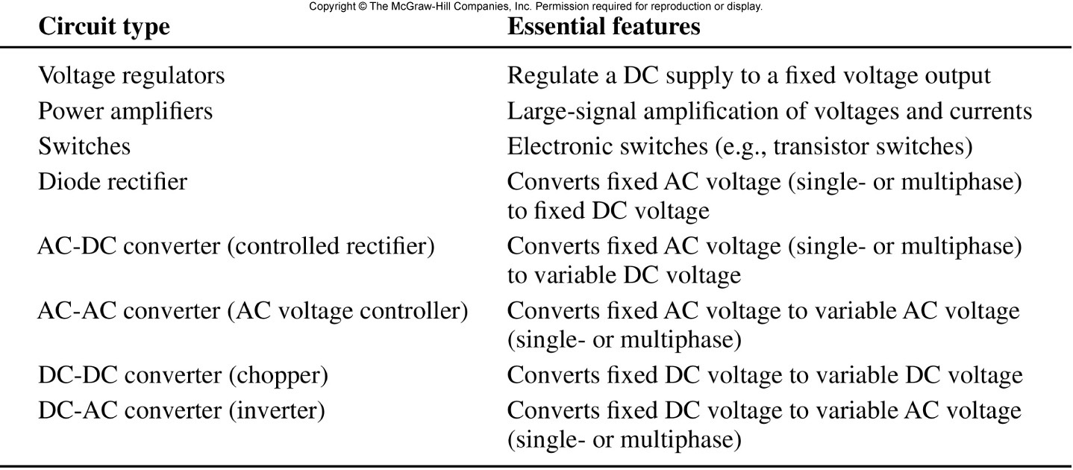
Table 12.1
Power Electric Circuits

Slide 7
Rectifiers Rectifiers may be classified as uncontrolled and controlled rectifiers. Controlled rectifiers can be further divided into semi-controlled and fully-controlled rectifiers. Uncontrolled rectifier circuits are built with diodes, and fully-controlled rectifier circuits are built with SCRs. Both diodes and SCRs are used in semi-controlled rectifier circuits.
Single-phase semi-controlled bridge rectifier
Single-phase fully-controlled bridge rectifier
Three-phase three-pulse, star-connected rectifier

Slide 8
Rectification
Converts AC to DC (fixed AC to fixed DC ) single phase
Located after Step up Transformer
On secondary side of Circuit
Can be single phase (1Φ)
Or 3 phase (3 Φ )

Slide 9
Rectification
process of changing AC to pulsed DC
rectifier
device that allows I to flow in only one direction
types valve tube solid state (semiconductor materials)
+
-
+
-
← I_{e}
I→
I→
← I_{e}

Slide 10
Crystal Diode Rectifier
The electric power available for transmission is usually AC supply,
but most of the electronic devices operate on DC supply.
So, we need to convert AC supply into DC.
The circuit used for converting AC into DC is known as rectifier .
Most of the rectifier circuit which uses crystal diode along with some
resistors for this conversion are known as crystal diode rectifier .

Slide 11
RECTIFIER DIODES

Slide 12
Introduction
A rectifier is an electrical device that converts alternating current (AC), which periodically reverses direction, to direct current (DC), which is in only one direction, a process known as rectification.

Slide 13
Types of Rectifiers
Half wave Rectifier
Full wave Rectifier
Bridge Rectifier

Slide 14
Lecture Outline
Half wave Rectifier
Full wave Rectifier
Bridge Rectifier

Slide 15
Half wave rectifier
In half wave rectification, either the positive or negative half of the AC wave is passed, while the other half is blocked.
Because only one half of the input waveform reaches the output, it is very inefficient if used for power transfer.

Slide 16
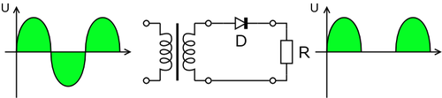
Half wave rectification

Slide 17


Output dc voltage calculation
The output DC voltage of a half wave rectifier can be calculated with the following two ideal equations

Slide 18
Half wave rectification

Slide 20
Effect of the Barrier Potential on the Half-Wave Rectifier Output
When the practical diode model is used with the
barrier potential of 0.7 V taken into account, this is
what happens. During the positive half-cycle, the
input voltage must overcome the barrier potential
before the diode becomes forward-biased. This results
in a half-wave output with a peak value that is 0.7 V
less than the peak value of the input, as shown in
The expression for the peak output voltage is

Slide 22
Peak Inverse Voltage (PIV)
The peak inverse voltage (PIV) equals the peak value
of the input voltage, and the diode must be capable of
withstanding this amount of repetitive reverse voltage.
For the diode in Figure 2–26, the maximum value of
reverse voltage, designated as PIV, occurs at the PIV, is maximum voltage a diode or other device can withstand in the reverse-biased direction without damaging itself. A diode should be rated at least
20% higher than the PIV.

Slide 24
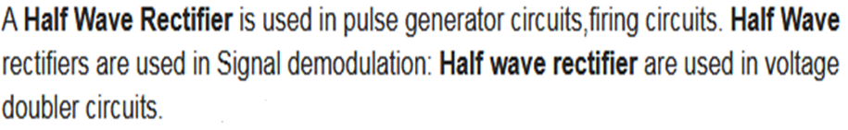
Application of half wave rectifier

Slide 25
Full wave rectification
For single-phase AC, if the transformer is center-tapped, then two diodes back-to-back (i.e. anodes-to-anode or cathode-to-cathode) can form a full-wave rectifier.

Slide 26
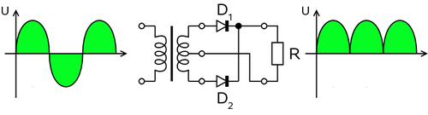
Full wave rectifier using transformer and 2 diodes

Slide 27
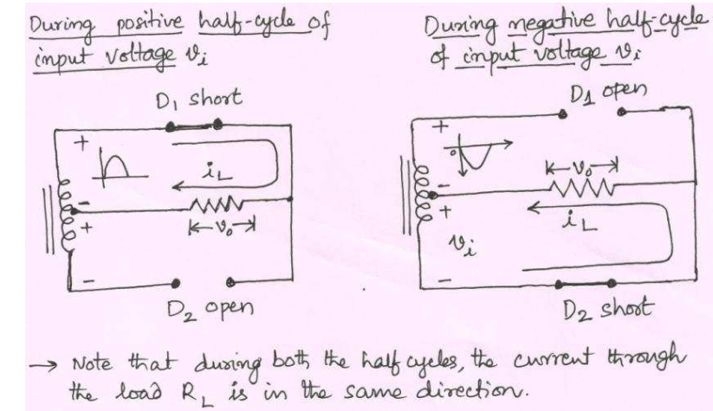
Full wave rectifier using transformer and 2 diodes

Slide 28
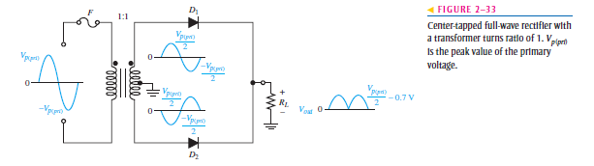

Slide 29
Full wave rectification
In a circuit with a non - center tapped transformer, four diodes are required instead of the one needed for half-wave rectification.

Slide 33
Full wave rectifier working animation

Slide 34
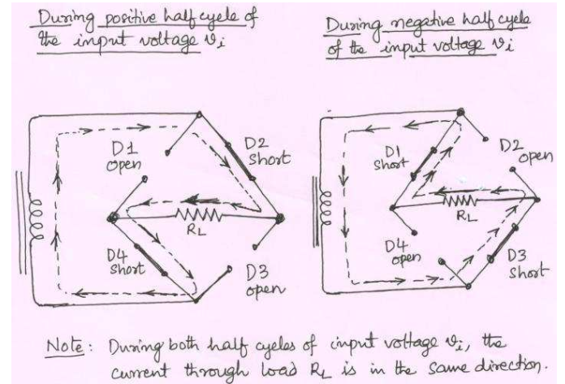
Bridge rectifier working animation

Slide 35


Formula
The average and root-mean-square output voltages of an ideal single phase full wave rectifier can be calculated as:

Slide 36
Output voltage of the full wave rectifier Animation

Slide 37
Bridge rectifier
A bridge rectifier makes use of four diodes in a bridge arrangement to achieve full-wave rectification.

Slide 38
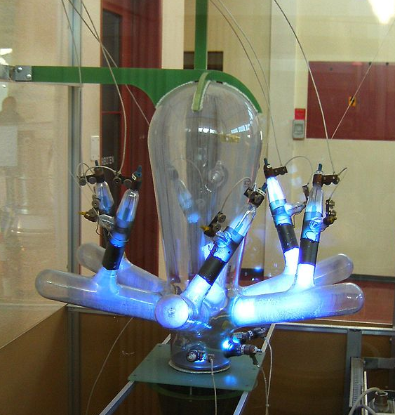
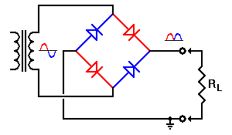
Origin of power electronics
Power electronics is the application of solid-state electronics for the control and conversion of electric power.
Power electronics started with the development of mercury arc rectifier. Invented by Peter Cooper Hewitt in 1902, the mercury arc rectifier was used to convert alternating current (AC) into direct current (DC).
mercury arc rectifier
1902-1970

Slide 39
Bridge rectifier working animation

Slide 40
Applications of the Full Wave Bridge Rectifier Circuit
Full Wave Bridge Rectifier is used to detect the amplitude of the modulating radio
signal. ... \
The Bridge Rectifier circuits are widely used in power supply for various appliances,
as they are capable of converting the High AC voltage into Low DC voltage.

Slide 41

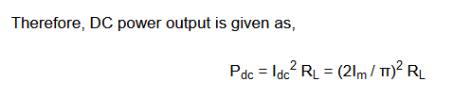

Efficiency of full wave rectifier

Slide 42
